Slide 1


Department of Computer Science and Engineering (Data Science)
LOGO DETECTION and BRAND RECOGNITION SYSTEM
USING AI and REAL-TIME IMAGE PROCESSING
Batch No: 07
S.Rishi Rupak (239P1A6724)
M.Karthik (239P1A6719)
I.Sathwik Reddy (239P1A6704)
M.Shiva Rama Krishna (239P1A6732)
Under the Guidance of
Ms.Farhana
Assistant Professor
Department of Computer Science and Engineering

Slide 2
OUTLINE
Abstract
Overall Design
Results Obtained
Performance Evaluation
Conclusion
Future Enhancements
References
Contribution Of The Project
100% Code

Slide 3
ABSTRACT
Logo detection is essential for brand monitoring, copyright enforcement, and digital marketing analytics. Traditional logo detection methods rely on manual inspection or rule-based image processing techniques, which lack scalability and accuracy. This project proposes an AI-powered Logo Detection System that utilizes deep learning techniques, including Convolutional Neural Networks (CNNs) and object detection models, to identify and classify logos in real-time. By integrating AI-driven image recognition and automated feature extraction, the system enhances brand visibility analysis and intellectual property protection

Slide 4
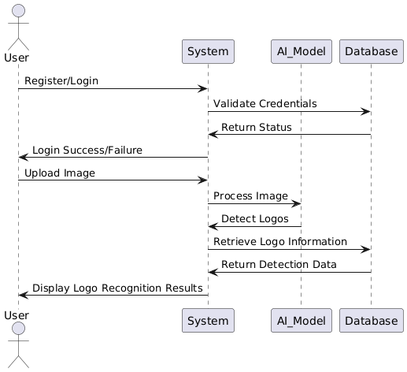
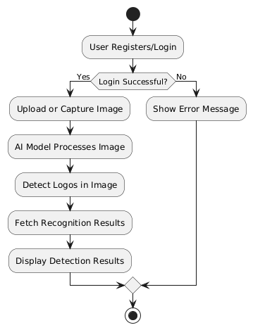
OVERALL DESIGN
Sequence Diagram
Activity Diagram

Slide 5
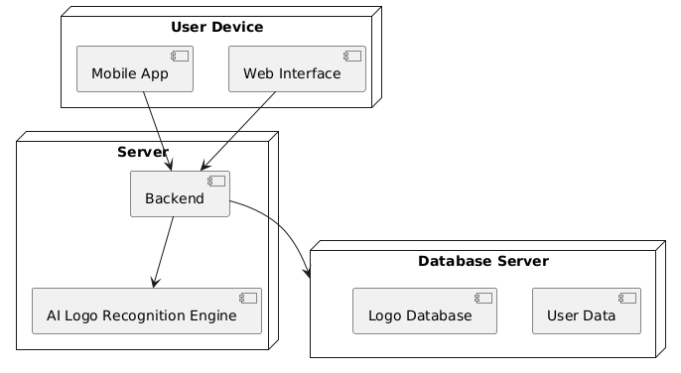
System Architecture

Slide 6


Experimental results
Fig 1 –Signup Page
Fig 2 – Home Page
15-03-2026

Slide 7
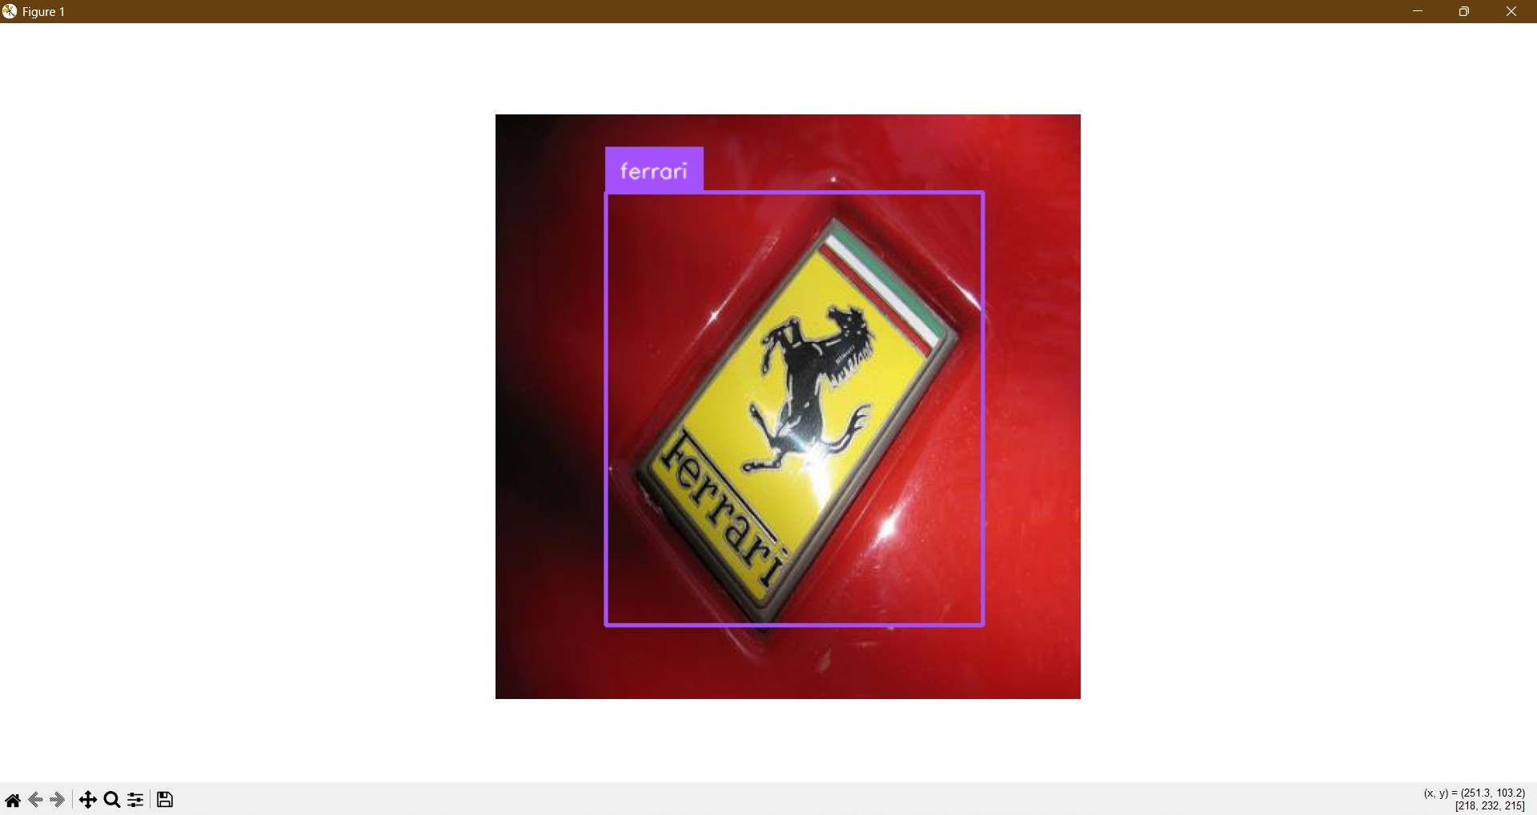
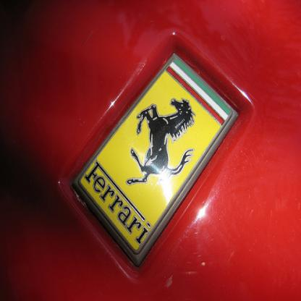
Experimental results
Fig 3 – Sign in page(login)
Fig 4 –Course Catalog
15-03-2026

Slide 8
Performance Evaluation
1.Detection Accuracy
The system correctly identifies logos from trained brands with good accuracy. Accuracy improves when more training images are added.
2.Real-Time Performance
The system processes live webcam input and provides predictions almost instantly. Each frame is captured, processed, and classified within a very short time, making the system suitable for real-time applications like surveillance and brand monitoring. There is no noticeable delay during execution.
3.Processing Efficiency
The complete pipeline, including image capture, preprocessing, and prediction, runs efficiently with minimal computational delay. The use of optimized libraries like OpenCV and TensorFlow helps in faster execution. Compared to manual logo detection, this system significantly reduces time and effort.

Slide 9
Conclusion
Successfully developed a Logo Detection and Brand Recognition System using AI and real-time image processing
Implemented a CNN-based model for accurate logo classification from images and live video
Designed an efficient pipeline for image preprocessing and prediction
Improved automation by eliminating manual logo identification
Built a scalable system that can be enhanced with advanced models like YOLO for object detection
Enhanced practical understanding of deep learning and computer vision concepts

Slide 10
Future Enhancements
1. Advanced Logo Detection (Bounding Box)
Implement object detection models like YOLO to detect exact logo location Improve accuracy by identifying multiple logos in a single image
2. Enhanced Model Accuracy
Increase dataset size with more logo variations Apply data augmentation for better performance under different lighting and angles
3. Real-Time Application Integration
Integrate the system with mobile cameras or CCTV for real-world usage Enable continuous real-time brand monitoring
4. Cloud & Mobile Deployment
Develop a mobile application for easy access Deploy the system on cloud for scalable and remote usage

Slide 11
REFERENCES
Brown, T., & White, M. (2019). "Deep Learning for Brand Logo Recognition in Digital Media." This study explores CNN-based architectures for automated logo detection.
Singh, R., & Patel, K. (2020). "AI-Powered Image Recognition for Trademark Protection." The research discusses AI-driven techniques for identifying logos in online content.
Nguyen, L., & Sharma, P. (2021). "Real-Time Object Detection for Brand Monitoring." This paper evaluates deep learning models for detecting logos in real-world environments.
Martinez, D., & Johnson, S. (2022). "AI-Based Visual Recognition for Counterfeit Detection." The authors present AI-driven solutions for brand protection using image recognition.
Garcia, H., & Lewis, F. (2023). "Enhancing Marketing Analytics with AI-Powered Logo Detection." This study examines AI applications in tracking brand exposure.
Chen, W., & Roberts, L. (2023). "Edge Computing for AI-Based Real-Time Logo Recognition." The paper explores AI-powered recognition models deployed on cloud and edge devices.
15-03-2026

Slide 12
CONTRIBUTION OF THE PROJECT
1.Academic Contribution
Enhances understanding of AI, deep learning, and computer vision concepts Provides hands-on experience in implementing CNN for real-world applications
2. Technical Contribution
Implements a CNN-based model for logo classification Integrates real-time image processing using OpenCV Demonstrates end-to-end pipeline from data preprocessing to prediction
3. User Contribution
Automates logo detection and reduces manual effort Provides quick and accurate brand identification Useful for applications like marketing analysis and brand monitoring
15-03-2026

Slide 13
100% Code Implementation
https://www.online-python.com/
15-03-2026

Slide 14
QUERIES ??
15-03-2026

Slide 15
THANK YOU
15-03-2026

